Slide 1
Next-Generation Smart Photo
Shengding Liu, Ziran Gao, Zhanwei Zhang, Yixian Zhou, Shuwei Zhang
2025.4.15

Slide 2
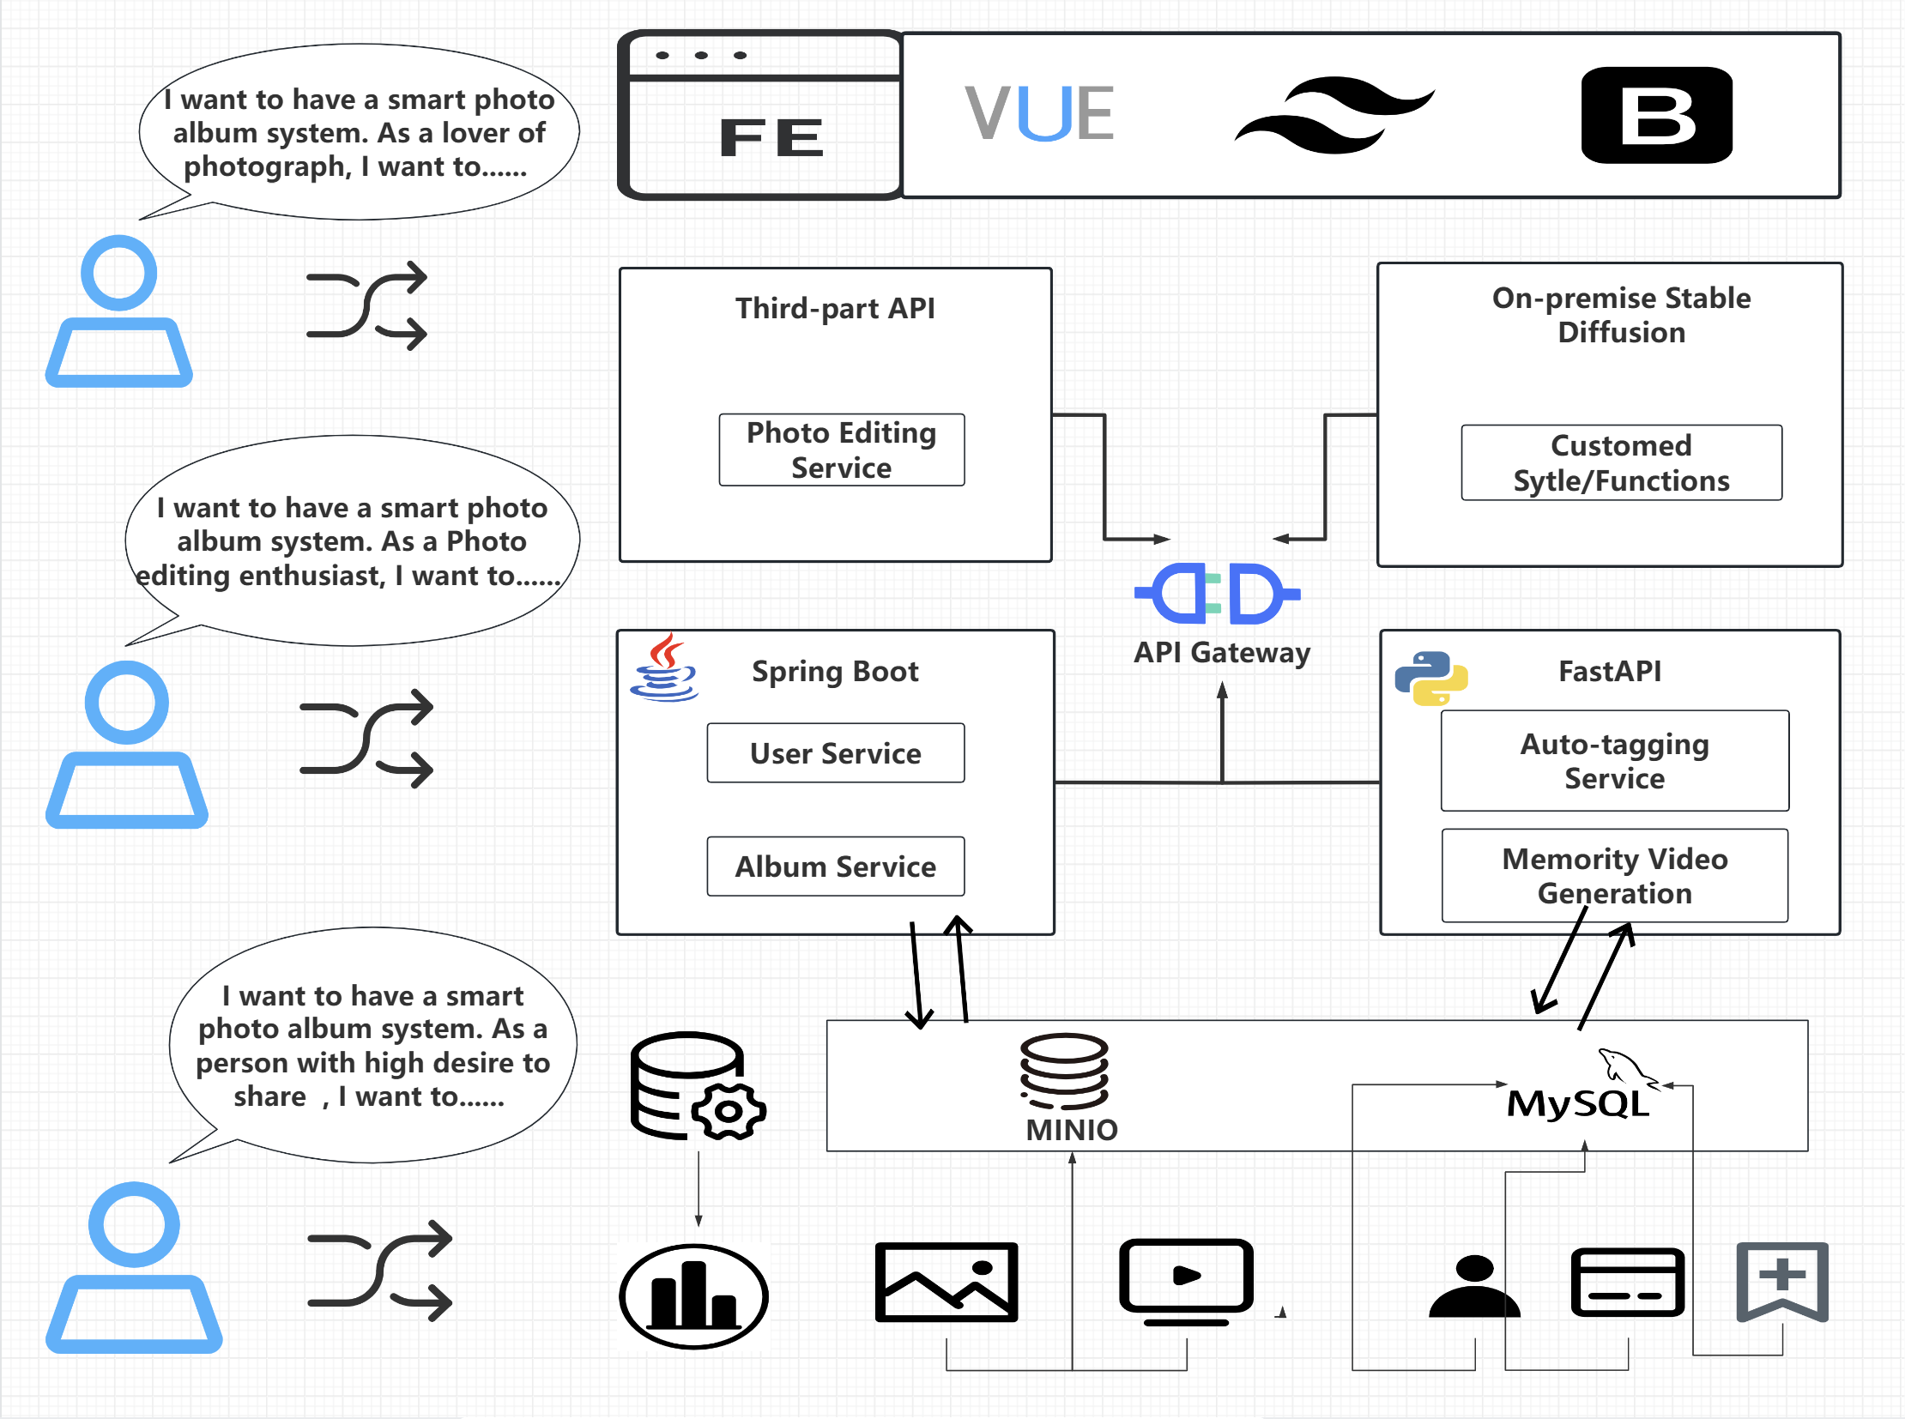
SYSTEM DESIGN

Slide 3
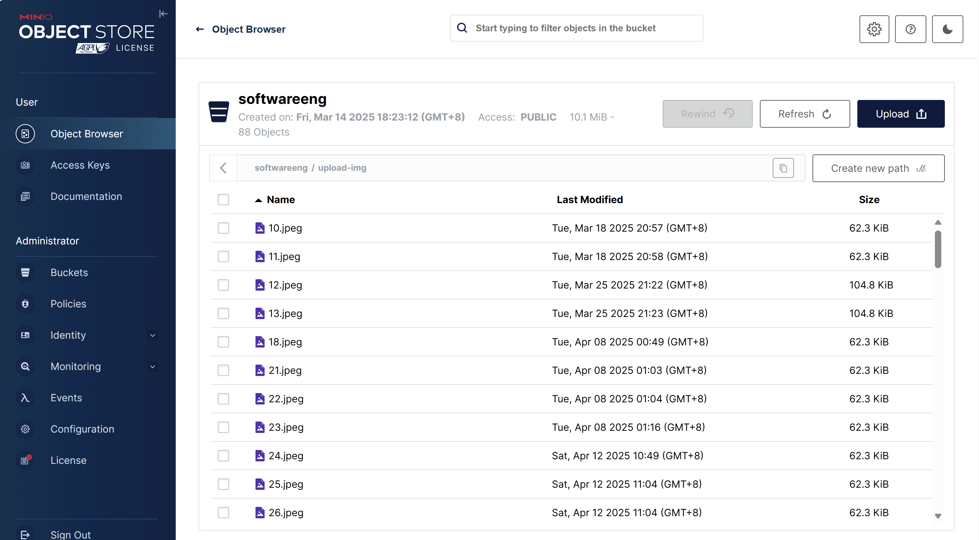
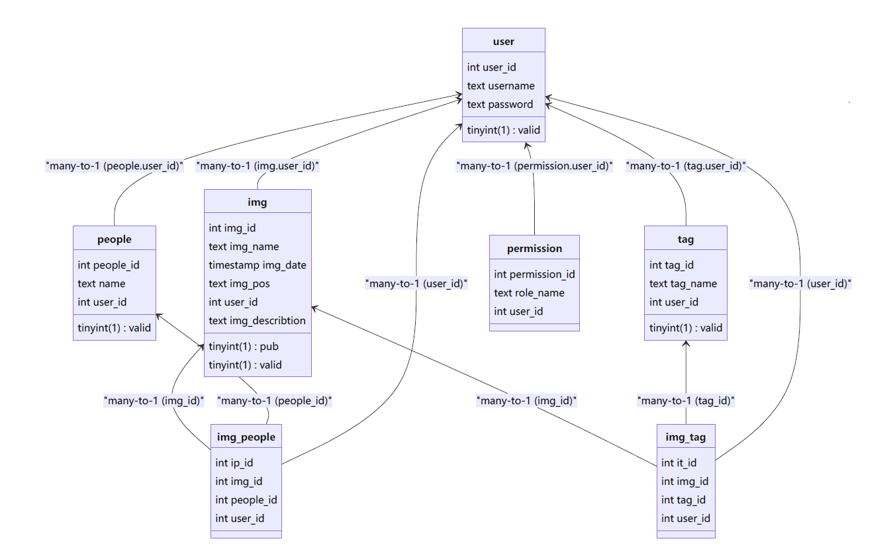
Database Design
MINIO for non-structured data
MySQL for structured data

Slide 4
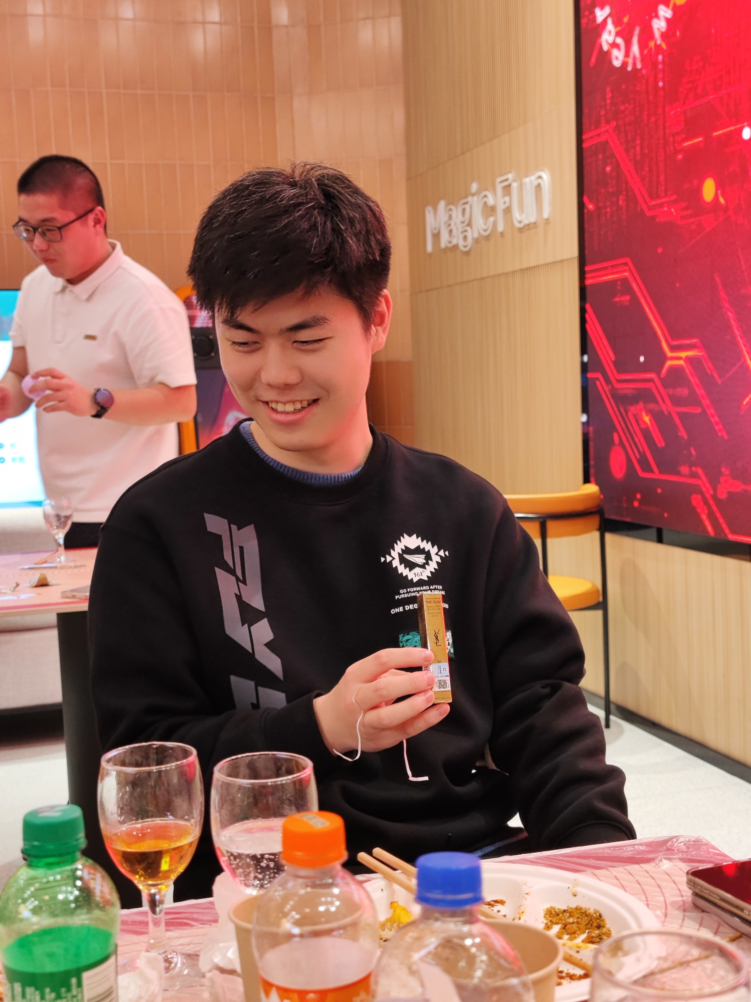
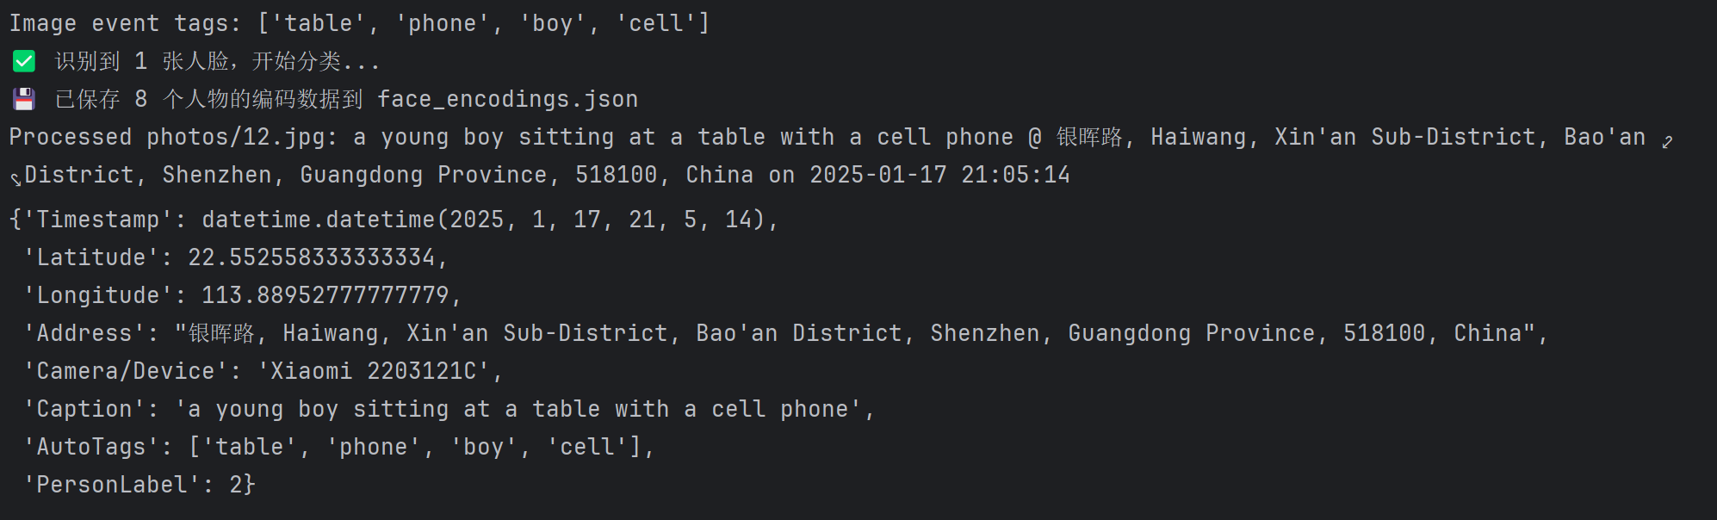

Slide 5
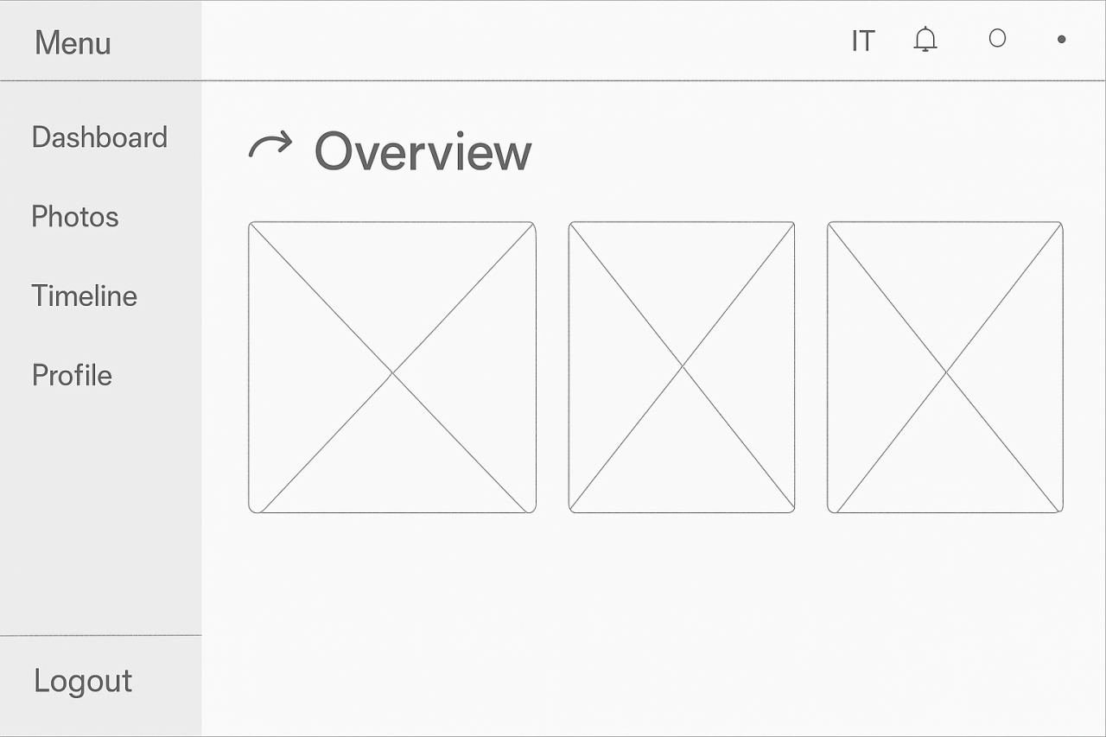
UI DESIGN

Slide 6
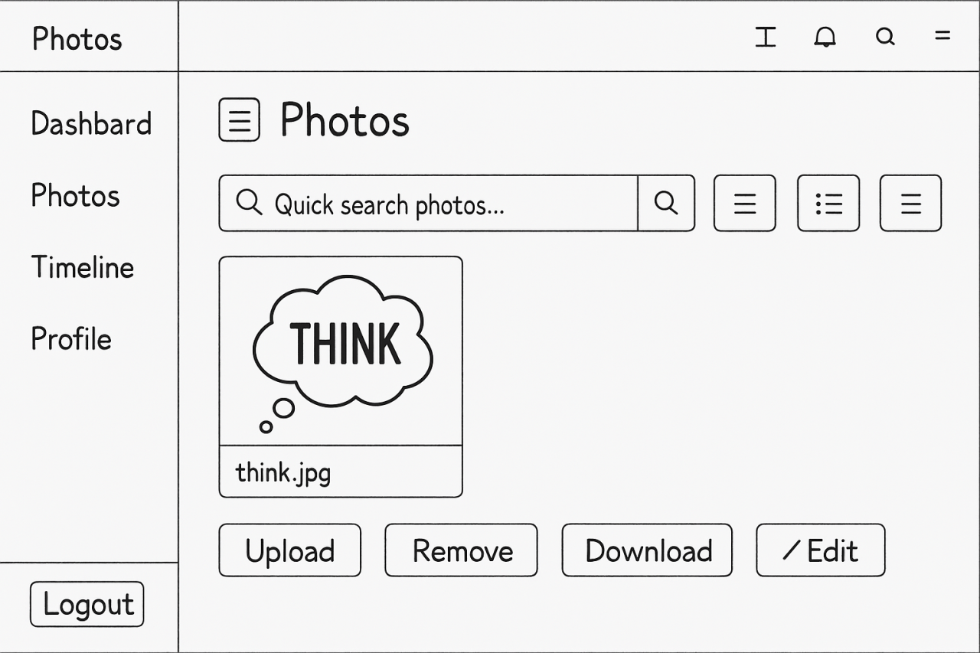
UI DESIGN

Slide 7
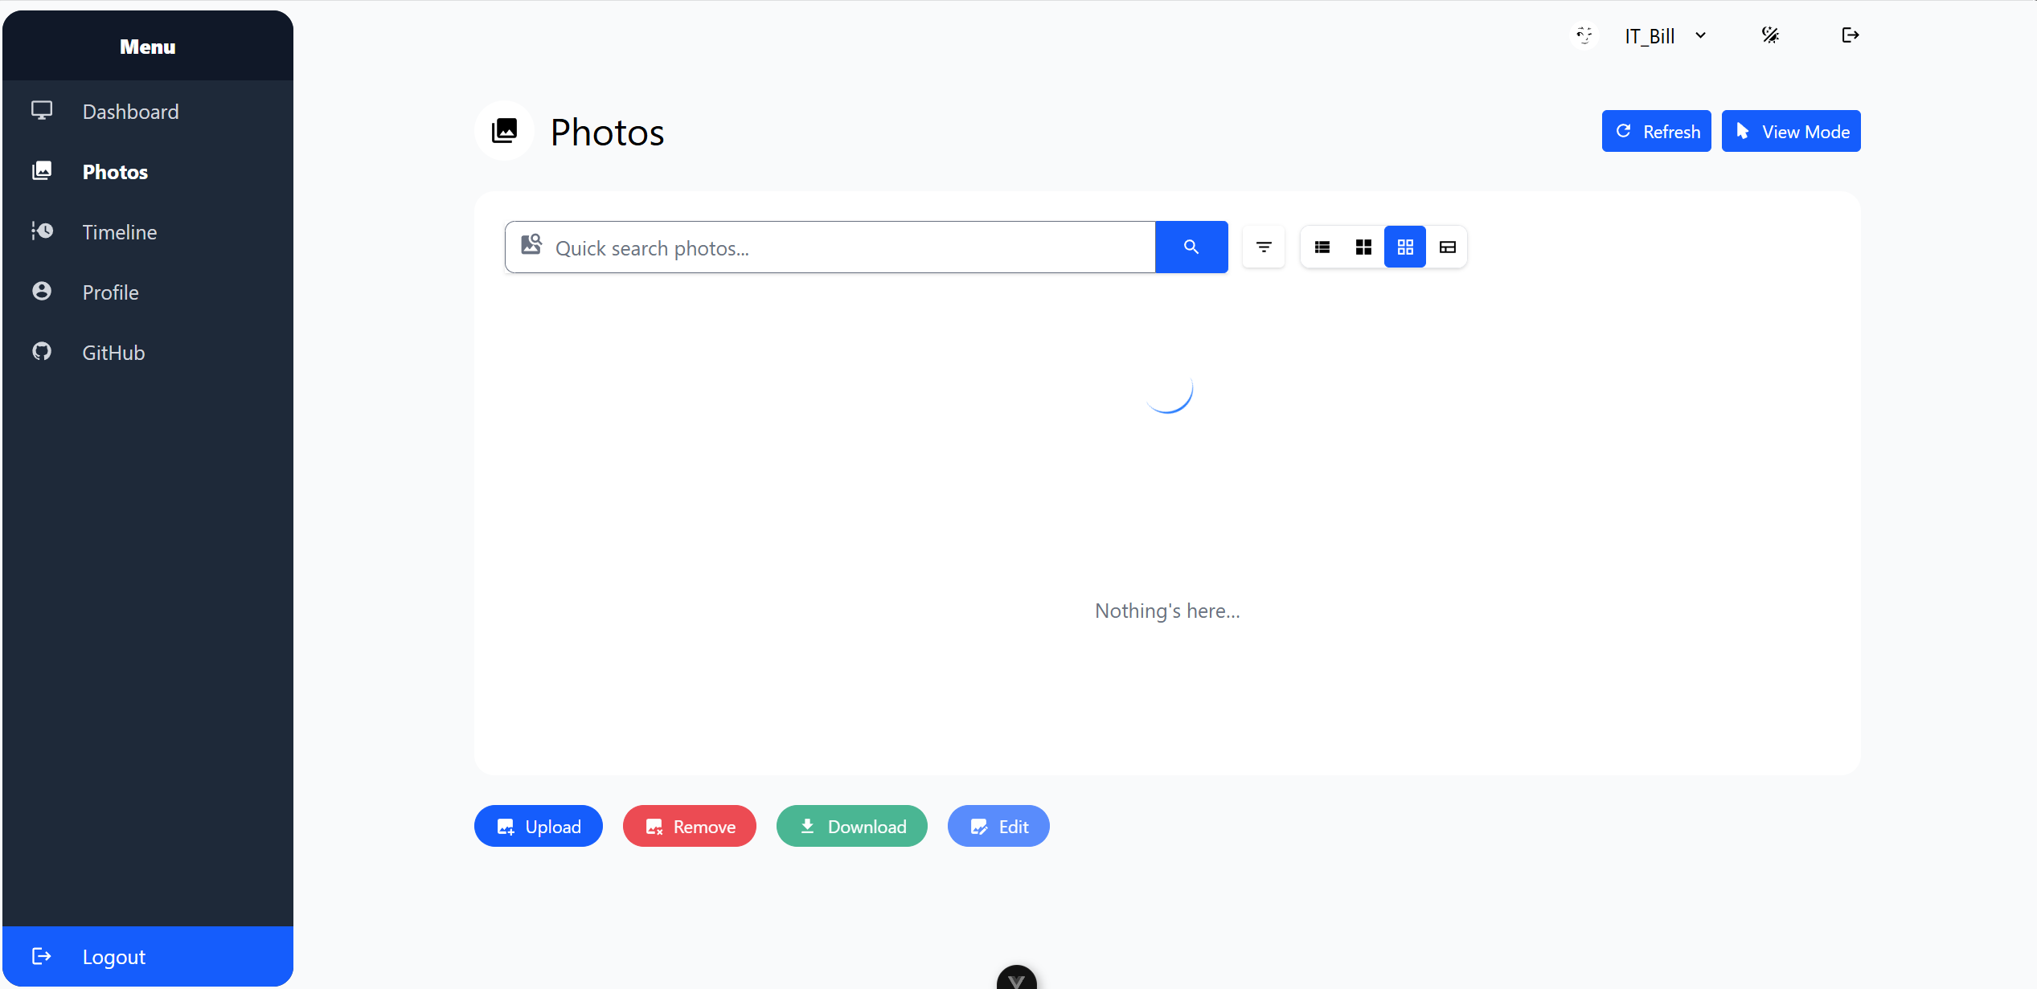
Demo Displaying

Slide 8
Next Sprint
Memory timeline design
Flash video generation
Upgraded people recognition
Smart Album with customed Style

Slide 9
Q & A
Thanks for listening!

